Slide 1
Diocesan Vision & Mission
Shared Vision & Mission, Shared Priorities, Shared Discernment
September 12, 2024 Business Office Forum ◊ St. John Parish, Adel

Slide 2
Overview
Gratitude
Lessons from geese: A Line of One Video
A Shared Vision and Mission
Shared Priorities
Shared Discernment
Q&A (Time for a few questions – I’ll be around at lunch for dialogue and questions)

Slide 3
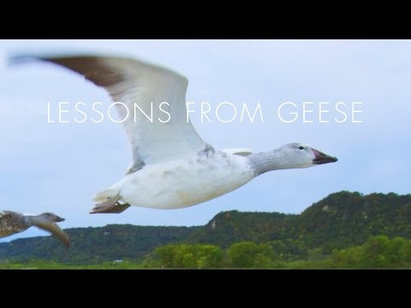
Lessons from Geese: a line of one

Slide 4
A Shared Vision and Mission
A Shared Vision and Mission – We sow God’s Spirit by cultivating connections in Christ through encounter, Friendship, and communion
Two reflection questions
  Rewinding the tapes of the last week when and how did you sow God’s spirit?
    Ponder moments with your family, your friends, your neighbors, and your parish community.
  Taking out the work you do on behalf of the Church of Southwest Iowa, what does it mean for YOU to cultivate connections in Christ through encounter, friendship, and communion?

Slide 5
Shared priorities
We will review our:
  Six Pastoral Priorities (and how to find them)
  The Welcome and care toolkit
  The parish engagement timeline

Slide 6
Parish engagement timeline

Slide 7
Shared discernment
Why is communal discernment vital?
  We are in mission as a community, not as individuals and we need to discern how the Holy Spirit is moving.
  Communal Discernment helps us
      Realize our current situation and the signs of the times as seen by Pete and Paul in the pew
      Rediscover our identity and mission
      Recognize God’s call for the present time
      Respond in concrete action
      Review our progress

Slide 8
Exploring the Discernment process
Designed to be a process where you don’t need guidance or a professional facilitator.
The motive behind this tool is to provide one for parishes who don’t have a process for pastoral planning.
It is a very flexible tool realizing that our parish communities can be a radically different places when it comes to pastoral planning
    Use what is most helpful for your community and disregard the rest, or use other parts of the process later when it makes sense
The ultimate goal is to discern where to begin in selecting a which priority(ies) your community wishes to engage
  Consider low hanging fruit:
    Quick wins that require acquisition of few resources, staffing, or effort)
    Something to lean into to strengthen a ministry outreach (priority) you have already been working on

Slide 9
Communal Discernment Exercise

Slide 10

questions

